Slide 1
Inline and Inheritance
Weiwei Xu

Slide 2
Overhead for a function call
•
the processing time required by a device prior to the execution of a command
•
•
•
Push parameters Push return address
Prepare return values
Pop all pushed

Slide 3
Inline Functions
•
An inline function is expanded in place, like a preprocessor macro, so the overhead of the function call is eliminated.

Slide 4
inline
int f(int i) {
return i*2;
}
main() {
int a = 4;
int b = f(a);
}

Slide 5
inline
inline int f(int i) {
return i * 2;
}
main() {
int a = 4;
int b = f(a);
}
int f(int i) {
return i*2;
}
main() {
int a = 4;
int b = f(a);
}

Slide 6
inline int f(int i) {
return i * 2;
}
main() {
int a = 4;
int b = f(a);
}
main() {
int a = 4;
int b = a + a;
}

Slide 7
Inline Functions
inline int plusOne(int x) {return ++x; };
•
•
•
The “definition”of an inline function should be put in a header file.
An inline function definition may not generate any code in .obj file.
It is declaration rather than definition.

Slide 8
Inline functions in header file
•
So you can put inline functions’ bodies in header file. Then #include it where the function is needed.
Never be afraid of multi-definition of inline functions, since they have no body at all.
Definitions of inline functions are just declarations.
•
•

Slide 9
Tradeoff of inline functions
•
•
•
•
Body of the called function is to be inserted into the caller.
This may expand the code size
but deduces the overhead of calling time. So it gains speed at the expenses of space. In most cases, it is worth.
It is much better than macro in C. It checks the types of the parameters.

Slide 10
#define f(a) (a)+(a)
main(){
double a = 4;
printf(“%d”, f(a));
}
Example: inline1.cpp
inline int f(int i){
return i*2;
}
main(){
double a = 4;
printf(“%d”, f(a));
}

Slide 11
Inline may not in-line
•
The compiler does not have to honor your request to make a function inline. It might decide the function is too large or notice that it calls itself (recursion is not allowed or indeed possible for inline functions), or the feature might not be implemented for your particular compiler.

Slide 12

Inline inside classes
•
Any function you define inside a class declaration is automatically an inline.
•
Example: Inline.cpp

Slide 13

Access functions
•
They are small functions that allow you to read or change part of the state of an object – that is, an internal variable or variables.
class Cup {
int color;
public:
int getColor() { return color; }
void setColor(int color){
this->color = color;
}
};

Slide 14
Pit-fall of inline
You can put the definition of an inline member function out of the class braces.
But the definition of the functions should be put before where they may be called.
•
•

Slide 15
Reducing clutter
•
Member functions defined within classes use the Latin in situ (in place) and maintains that all definitions should be placed outside the class to keep the interface clean.
•
Example: Noinsitu.cpp

Slide 16
Inline or not?

Slide 17
Inline or not?
•
Inline:
•
•
Small functions, 2 or 3 lines
Frequently called functions, e.g. inside loops

Slide 18
Inline or not?
•
Inline:
•
•
Small functions, 2 or 3 lines
Frequently called functions, e.g. inside loops
•
Not inline?
•
•
Very large functions, more than 20 lines Recursive functions

Slide 19
Inline or not?
•
Inline:
•
•
Small functions, 2 or 3 lines
Frequently called functions, e.g. inside loops
•
Not inline?
•
•
Very large functions, more than 20 lines Recursive functions
•
A lazy way
•
•
Make all your functions inline
Never make your functions inline

Slide 20
Composition
Code-reuse in OOP

Slide 21
Composition
Objects can be used to build up other objects
Ways of inclusion
  Fully
  By reference
Inclusion by reference allows sharing
For example, an Employee has a
  Name
  Address
  Health Plan
  Salary History
    Collection of Raise objects
  Supervisor
    Another Employee object!

Slide 22
Reusing the implementation
Composition: construct new object with existing objects
It is the relationship of “has-a”
car
engine
tyre

Slide 23
Composition in action
Classes
Instances
Employee
Name Address HealthPlan
Salary History
Supervisor
Henry Higgins
home address
raises
YAHMO
Bill C.

Slide 24
Example
class Person { … };
class Currency { … };
class SavingsAccount {
public:
SavingsAccount( const char* name,
const char* address, int cents);
~SavingsAccount();
void print();
private:
Person m_saver;
Currency m_balance;
};

Slide 25
Example…
SavingsAccount::SavingsAccount(const char* name, const char* address, int cents): m_saver(name, address), m_balance(0, cents)
{}
void SavingsAccount::print()
{
m_saver.print();
m_balance.print();
}

Slide 26
Embedded objects
All embedded objects are initialized
  The default constructor is called if
    you don’t supply the arguments, and there is a default constructor (or one can be built)
Constructors can have initialization list
  any number of objects separated by commas
  is optional
  Provide arguments to sub-constructors
Syntax:
name(
args
) [‘:’
init-list] ‘{‘

Slide 27
Question
If we wrote the constructor as (assuming we have the set accessors for the sub-objects):
SavingsAccount::SavingsAccount(const char* name,
const char* address, int cents ) {
m_saver.set_name( name );
m_saver.set_address( address );
m_balance.set_cents( cents );
}
Default constructors would be called

Slide 28
Public vs. Private
It is common to make embedded objects private:
  they are part of the underlying implementation
  the new class only has part of the public interface of the old class
Can embed as a public object if you want to have the entire public interface of the subobject available in the new object:
class SavingsAccount{
public:
Person m_saver;
...
}； // assume Person class has set_name()
SavingsAccount account;
account.m_saver.set_name("Fred");

Slide 29
Inheritance
Code-reuse in OOP

Slide 30
Inheritance
Language implementation technique
Also an important component of the OO design methodology
Allows reusing and sharing of design for
  Member data
  Member functions
  Interfaces
Key technology in C++

Slide 31
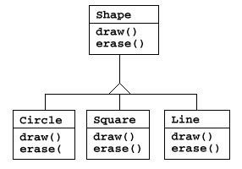
Reusing the interface
Inheritance is to take the existing class, clone it, and then make additions and modifications to the clone.

Slide 32


Inheritance
The ability to define the behavior or implementation of one class as a superset of another class
Person
Student

Slide 33
DoME
is an application that let us store information about CDs and DVDs. We can
  enter information about CDs and DVDs
  search, for example, all CDs in the database by a certain artist, or all DVDs by a given director

Slide 34
the title of the album;
CD
the artist (name of the band or singer);
the number of tracks on the CD;
the total playing time;
a ‘got it’ flag that indicates whether I own a copy of this CD;
and a comment (some arbitrary text).

Slide 35
the title of the DVD;
DVD
the name of the director;
the playing time (we define this as the playing time of the main feature);
a ‘got it’ flag that indicates whether I own a copy of this DVD;
and a comment (some arbitrary text).

Slide 36
The DoME example
"Database of Multimedia Entertainment"
stores details about CD and DVDs
  CD: title, artist, #tracks, playing time, got-it, comment
  DVD: title, director, playing time, got-it, comment
allows (later) to search for information or print lists

Slide 37


DoME classes
:CD :DVD
title
title
artist
director
#tracks
playing time
playing time
got it
got it
comment
comment

Slide 38
Class diagram
CD
DVD
title
artist
numberOfTracks playingTime
gotIt
comment
top half shows fields
title
director
playingTime gotIt
comment
setComment getComment setOwn
getOwn
print
setComment getComment setOwn
getOwn
print
bottom half shows methods

Slide 39
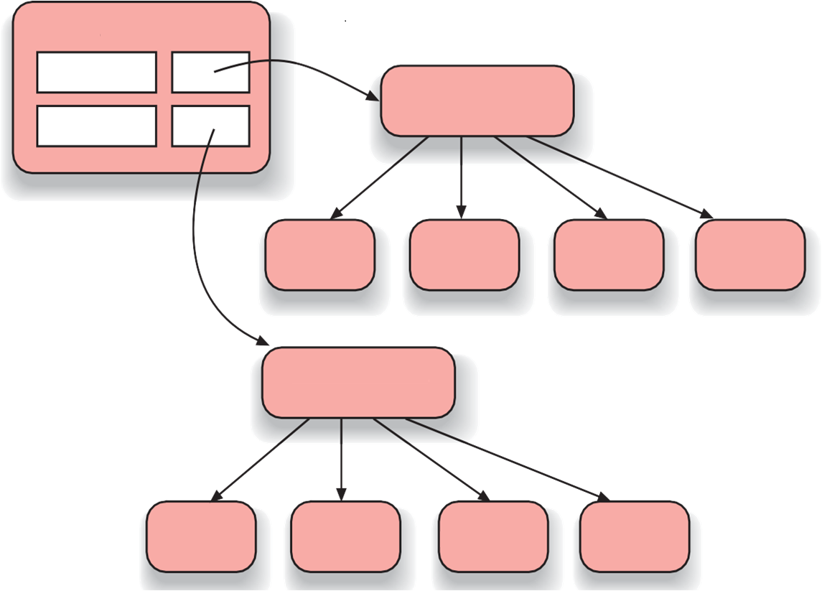
Object Model
:Database
cds
:ArrayList<CD>
dvds
:CD
:CD
:CD
:CD
:ArrayList<DVD>
:DVD
:DVD
:DVD
:DVD

Slide 40
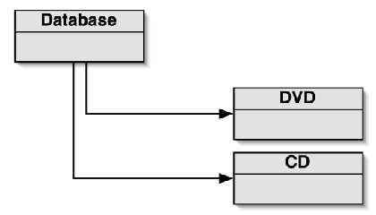
Class diagram

Slide 41
Source code
public class Database
{
private ArrayList<CD> cds;
private ArrayList<DVD> dvds;
}

Slide 42
source code
public class Database
{
private ArrayList<CD> cds;
private ArrayList<DVD> dvds;
}
public void addCD( CD theCD )
{
cds.add(theCD);
}
public void addDVD(DVD theDVD)
{
dvds.add(theDVD);
}

Slide 43
source code
public class Database
{
private ArrayList<CD> cds;
private ArrayList<DVD> dvds;
}
public void list()
{
// print list of CDs
for(CD cd : cds) {
cd.print();
System.out.println();
}
// print list of DVDs
for(DVD dvd : dvds) {
dvd.print();
System.out.println();
}
}
public void addCD( CD theCD )
{
cds.add(theCD);
}
public void addDVD(DVD theDVD)
{
dvds.add(theDVD);
}

Slide 44
Critique of DoME
code duplication
  CD and DVD classes very similar (large part are identical)
  makes maintenance difficult/more work
  introduces danger of bugs through incorrect maintenance
code duplication also in Database class

Slide 45
Discuss
The CD and DVD classes are very similar. In fact, the majority of the classes’ source code is identical, with only a few differencesc
In the Database class. We can see that everything in that class is done twice – once for CDs and once for DVDs
What if we’d add new types of media?

Slide 46
Solution - inheritance
Item
title playingTime gotIt comment
setComment getComment setOwn getOwn print
CD
artist numberOfTracks
getArtist getNumberOfTracks
DVD
director
getDirector
Inheritance allows us to define one class as an extension of another.

Slide 47
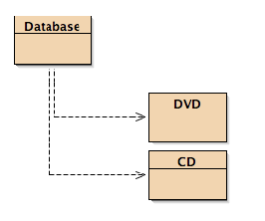
Class diagram

Slide 48

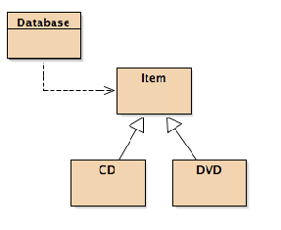
Class diagram

Slide 49
Using inheritance
define one superclass : Item
define subclasses for Video and CD
the superclass defines common attributes
the subclasses inherit the superclass attributes
the subclasses add own attributes

Slide 50
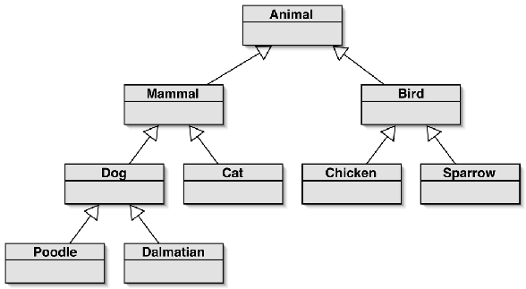
Inheritance hierarchies

Slide 51
Inheritance
no change here
class Item
{
...
}
change here
class DVD : public Item
{
...
}
class CD : public Item
{
...
}

Slide 52
Database v2.0

Slide 53

Database v2.0
public void addItem(Item theItem)
{
items.add(theItem);
}
/**
Print a list of all
the text terminal.
*/
public void list()
{
currently
stored items to
for(Item item :items){
item.print();
System.out.println(); // empty line between items
}
}

Slide 54
public void
{
addCD(CD theCD)
cds.add(theCD);
}
public void
{
addDVD(DVD theDVD)
dvds.add(theDVD);
}

Slide 55

public void
{
addCD(CD theCD)
cds.add(theCD);
}
public void addItem(Item theItem)
{
items.add(theItem);
}
public void
{
addDVD(DVD theDVD)
dvds.add(theDVD);
}

Slide 56
public
void
list()
{
// print
list of CDs
{
for(CD cd : cds)
cd.print(); System.out.println();
}
// print list of DVDs
for(DVD dvd :dvds){
dvd.print(); System.out.println();
}
}

Slide 57

public
void
list()
{
// print
list of CDs
for(CD cd : cds) {
public void list()
{
for(Item item:items){
item.print();
System.out.println();
}
}
ntln();
VDs
{
cd.print(); System.out.pri
}
// print list of D
for(DVD dvd : dvds)
dvd.print();
System.out.println();
}
}

Slide 58
Adding other item types
Item
title playingTime gotIt comment
*
* methods not shown
CD
artist numberOfTracks
*
DVD
director
*
VideoGame
numberOfPlayers platform
*

Slide 59
Deeper hierarchies
Item
title playingTime gotIt comment
*
* methods not shown
CD
artist numberOfTracks
*
DVD
director
*
Game
numberOfPlayers
*
VideoGame
director
*
BoardGame
director
*

Slide 60
Advantages of inheritance
Avoiding code duplication
Code reuse
Easier maintenance
Extendibility

Slide 61
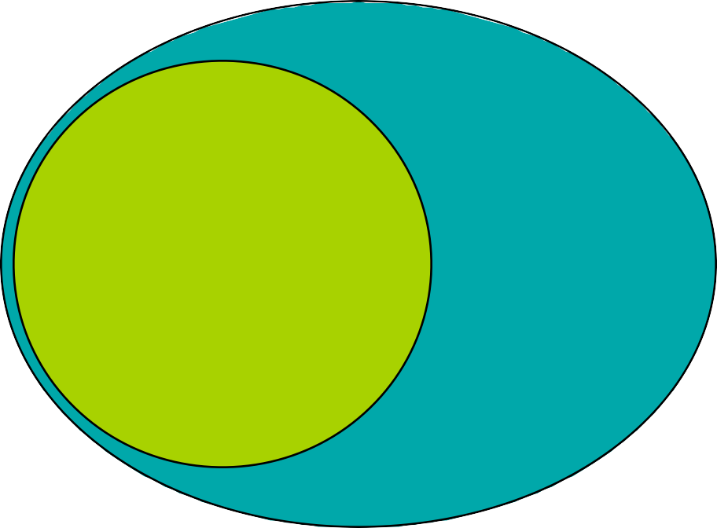
Inheritance
The ability to define the behavior or implementation of one class as a superset of another class
Person
Student

Slide 62
Inheritance
Class relationship: Is-A
Employee
Base Class Super Parent
Derived Class Sub
Child
Manager

Slide 63
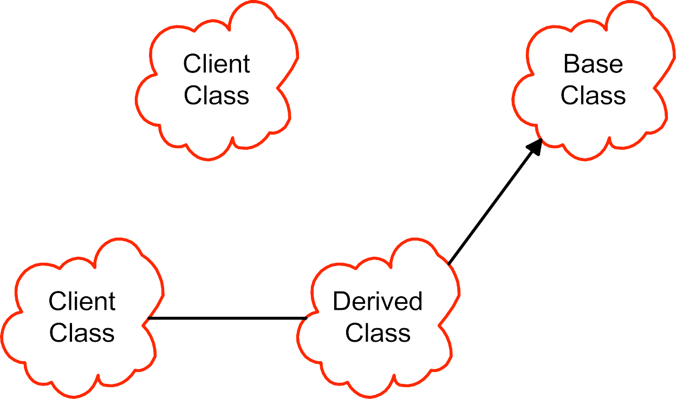


Scopes and access in C++

Slide 64
Declare an Employee class
class Employee {
public:
Employee( const std::string& name,
const std::string& ssn );
const std::string& get_name() const;
void print(std::ostream& out) const;
void print(std::ostream& out,
const std::string& msg) const;
protected:
std::string m_name;
std::string m_ssn;
};

Slide 65
Constructor for Employee
Employee::Employee( const string& name,
const string& ssn )
: m_name(name), m_ssn( ssn)
{
// initializer list sets up the values!
}

Slide 66
Employee member functions
inline const std::string& Employee::get_name() const
{
return m_name;
}
inline void Employee::print( std::ostream& out ) const
{
out << m_name << endl;
out << m_ssn << endl;
}
inline void Employee::print(std::ostream& out,
const std::string& msg) const
{
out << msg << endl;
print(out);
}

Slide 67
Now add Manager
class Manager : public Employee {
public:
Manager(const std::string& name,
const std::string& ssn,
const std::string& title);
const std::string title_name() const;
const std::string& get_title() const;
void print(std::ostream& out) const;
private:
std::string m_title;
};

Slide 68
Inheritance and constructors
Think of inherited traits as an embedded object
Base class is mentioned by class name
Manager::Manager( const string& name, const string&
ssn, const string& title = "" )
:Employee(name, ssn), m_title( title )
{
}

Slide 69
More on constructors
Base class is always constructed first
If no explicit arguments are passed to base class
– Default constructor will be called
Destructors are called in exactly the reverse order of the constructors.

Slide 70
Manager member functions
inline void Manager::print( std::ostream& out ) const
{
Employee::print( out ); //call the base class print
out << m_title << endl;
}
inline const std::string& Manager::get_title() const
{
return m_title;
}
inline const std::string Manager::title_name() const
{
return string( m_title + ": " + m_name );
// access base m_name
}

Slide 71
Uses
int main () {
Employee bob( "Bob Jones", "555-44-0000" );
Manager bill( "Bill Smith", "666-55-1234", "ImportantPerson" );
string name = bill.get_name(); // okay Manager inherits Employee
//string title = bob.get_title(); // Error -- bob is an Employee!
cout << bill.title_name() << '\n' << endl;
bill.print(cout);
bob.print(cout);
bob.print(cout, "Employee:");
//bill.print(cout, "Employee:"); // Error hidden!
}

Slide 72
Name Hiding
If you redefine a member function in the derived class, all other overloaded functions in the base class are inaccessible.
We'll see how the keyword virtual affects function overloading next time.

Slide 73
What is not inherited?

Slide 74
What is not inherited?
Constructors
  synthesized constructors use memberwise initialization
  In explicit copy ctor, explicity call base-class copy ctor or the default ctor will be called instead.

Slide 75
What is not inherited?
Constructors
  synthesized constructors use memberwise initialization
  In explicit copy ctor, explicity call base-class copy ctor or the default ctor will be called instead.
Destructors

Slide 76
What is not inherited?
Constructors
  synthesized constructors use memberwise initialization
  In explicit copy ctor, explicity call base-class copy ctor or the default ctor will be called instead.
Destructors
Assignment operation
  synthesized operator= uses memberwise assignment
  explicit operator= be sure to explicity call the base class version of operator=

Slide 77
What is not inherited?
Constructors
  synthesized constructors use memberwise initialization
  In explicit copy ctor, explicity call base-class copy ctor or the default ctor will be called instead.
Destructors
Assignment operation
  synthesized operator= uses memberwise assignment
  explicit operator= be sure to explicity call the base class version of operator=
Private data is hidden, but still present

Slide 78
Access protection

Slide 79
Access protection
Members
  Public: visible to all clients
  Protected: visible to classes derived from self (and to friends)
  Private: visible only to self and to friends!

Slide 80
Access protection
Members
  Public: visible to all clients
  Protected: visible to classes derived from self (and to friends)
  Private: visible only to self and to friends!
Inheritance
– Public:
class Derived : public Base ...
– Protected: class Derived : protected Base ...
Private:
class Derived : private Base ...
default

Slide 81
How inheritance affects access
Suppose class B is derived from A. Then:
Base class member access specifier
Inheritance Type( B is ) | public | protected | private
public A | public in B | protected in B | hidden
private A | private in B | private in B | hidden
protected A | protected in B | protected in B | hidden

Slide 82
When is protected not protected?
When your derived classes are ill- behaved!
Protected is public to all derived classes
For this reason
  make member functions protected
  keep member variables private
Client
Base Class
Derived class

Slide 83
Conversions
Public Inheritance should imply substitution
  If B isa A, you can use a B anywhere an A can be used.
    if B isa A, then everything that is true for A is also true of B.
  Be careful if the substitution is not valid!

Slide 84
Up-casting
Is to regard an object of the derived class as an object of the base class.
It is to say: Students are human beings. You are students. So you are human being.
Human being
Students

Slide 85
Upcasting
Upcasting is the act of converting from a Derived reference or pointer to a base class reference or pointer.
Base
Derived

Slide 86
Upcasting examples
Manager pete( "Pete", "444-55-6666", "Bakery"); Employee* ep = &pete; // Upcast
Employee& er = pete; // Upcast
Lose type information about the object:
ep->print( cout ); // prints base class version

Slide 87
A drawing program
Rectangle
Circle
Ellipse
Operations
render
move
resize
Data
+ center

Slide 88
Inheritance in C++
Can define one class in terms of another
Can capture the notion that
– An ellipse is a shape
Ellipse
A circle is a special kind of ellipse
A rectangle is a different shape
Shape
Circles, ellipses, and rectangles share common
  attributes
  services
Circles, ellipses, and rectangles are not identical
Circle

Slide 89

Conceptual model
Shape
center move() render()
Rectangle
render()
Ellipse
render()
Square
render()
Circle
render()
Note: Deriving Circle from Ellipse is a poor design choice!

Slide 90
In C++
Define the general properties of a Shape
class XYPos{ ... }; // x,y point
class Shape {
public:
Shape();
virtual ~Shape();
virtual void render();
void move(const XYPos&);
virtual void resize();
protected:
XYPos center;
};

Slide 91
Polymorphism

Slide 92
Polymorphism
Upcast: take an object of the derived class as an object of the base one.
– Ellipse can be treated as a Shape

Slide 93
Polymorphism
Upcast: take an object of the derived class as an object of the base one.
  Ellipse can be treated as a Shape
Dynamic binding:
  Binding: which function to be called
    Static binding: call the function as the code
    Dynamic binding: call the function of the object

Slide 94
Virtual functions

Slide 95
Virtual functions
Non-virtual functions
  Compiler generates static, or direct call to stated type
  Faster to execute

Slide 96
Virtual functions
Non-virtual functions
  Compiler generates static, or direct call to stated type
  Faster to execute
Virtual functions
  Can be transparently overridden in a derived class
  Objects carry a pack of their virtual functions
  Compiler checks pack and dynamically calls the right function
  If compiler knows the function at compile-time, it can generate a static call

Slide 97
Add new shapes
class Ellipse : public Shape {
public:
Ellipse(float maj, float minr);
virtual void render(); // will define own
protected:
float major_axis, minor_axis;
};
class Circle : public Ellipse {
public:
Circle(float radius):Ellipse(radius, radius){}
virtual void render();
};

Slide 98
Example
void render(Shape* p) {
p->render(); // calls correct render function
} // for given Shape!
void func() {
Ellipse ell(10, 20);
ell.render(); // static -- Ellipse::render();
Circle circ(40);
circ.render(); // static -- Circle::render();
render(&ell); // dynamic -- Ellipse::render();
render(&circ); // dynamic -- Circle::render()
}

Slide 99
Abstract base classes
An abstract base class has pure virtual functions
  Only interface defined
  No function body given
Abstract base classes cannot be instantiated
  Must derive a new class (or classes)
  Must supply definitions for all pure virtuals before class can be instantiated

Slide 100
In C++
Define the general properties of a Shape
class XYPos{ ... }; // x,y point
class Shape {
public:
Shape();
virtual void render() = 0; // mark
render() pure
void move(const XYPos&);
virtual void resize();
protected:
XYPos center;
};

Slide 101
Abstract classes
Why use them?
  Modeling
  Force correct behavior
  Define interface without defining an implementation
When to use them?
  Not enough information is available
  When designing for interface inheritance

Slide 102
Protocol/Interface classes
Abstract base class with
  All non-static member functions are pure virtual except destructor
  Virtual destructor with empty body
  No non-static member variables, inherited or otherwise
    May contain static members

Slide 103
Example interface
Unix character device
class CDevice {
public:
virtual ~CDevice();
virtual int read(...) = 0;
virtual int write(...) = 0;
virtual int open(...) = 0;
virtual int close(...) = 0;
virtual int ioctl(...) = 0;
};

Slide 104
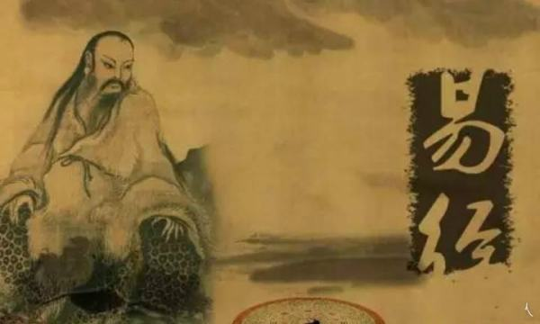
Inheritance+Polymorphism
-从中国古代哲学的观点来解读
“形而上者谓之道，形而下者谓之器”
来自易经·系辞，中国人很重视这个“道”，认为它是起主导作用的，它支配着“地”上的一切“形”、“器”、“象”。
继承与多态是为建模世界中多样化的对象提取出来的道，有了这个规律可以有效地组织对象知识和行为。
继承与多态的“道”指导了OOP语法的设计，指导了面向对象系统的设计。

Slide 105
Container

Slide 106
A personal notebook
It allows notes to be stored.
It has no limit on the number of notes it can
store.
It will show individual notes.
It will tell us how many notes it is currently
storing.

Slide 107
Collection
Collection objects are objects that can store an arbitrary number of other objects.

Slide 108
What is STL
STL = Standard Template Library
Part of the ISO Standard C++ Library
Data Structures and algorithms for C++.

Slide 109
Why should I use STL?
Reduce development time.
–Data-structures already written and debugged.
Code readability
–Fit more meaningful stuff on one page.
Robustness
–STL data structures grow automatically.
Portable code.
Maintainable code
Easy

Slide 110
C++ Standard Library
Library includes:
–A Pair class (pairs of anything, int/int, int/char, etc)
–Containers
  Vector (expandable array)
  Deque (expandable array, expands at both ends)
  List (double-linked)
  Sets and Maps
–Basic Algorithms (sort, search, etc)
All identifiers in library are in std namespace
using namespace std;

Slide 111
The three parts of STL
Containers
Algorithms
Iterators

Slide 112
The ‘Top 3’ data structures
map
–Any key type, any value type.
–Sorted.
vector
–Like c array, but auto-extending.
list
–doubly-linked list

Slide 113
All Sequential Containers
vector: variable array
deque: dual-end queue
list: double-linked-list
forward_list: as it
array: as “array”
string: char. array

Slide 114
Example using the vector class
Use “namespace std” so that you can refer to vectors in C++ library
Just declare a vector of
ints (no need to worry about size)
Add elements
Have a pre-defined iterator for vector class,
#include <iostream>
#include <vector>
using namespace std;
int main( ) {
vector<int> x;
for (int a=0; a<1000; a++) x.push_back(a);
vector<int>::iterator p;
for (p=x.begin();
p<x.end(); p++)
cout << *p << " "; return 0;
can use it to print out the items in vector
}

Slide 115
generic classes
vector<string> notes;
Have to specify two types: the type of the collection itself (here: vector) and the type of the elements that we plan to store in the collection (here: string)

Slide 116
vector
It is able to increase its internal capacity as required: as more items are added, it simply makes enough room for them.
It keeps its own private count of how many items it is currently storing. Its size method returns the number of objects currently stored in it.
It maintains the order of items you insert into it. You can later retrieve them in the same order.

Slide 117
Class Exercises
Write a code to test vector. Put 5000 items in the vector, and then prints out every fifth element
–Element 0, element 5, element 10, etc.

Slide 118
Basic Vector Operations
Constructors vector<Elem> c; vector<Elem> c1(c2);
Simple Methods
Element access V.at(index)
V[index]
V.front( )
V.back( )
// first item
// last item
V.size( )
V.empty( )
// num items
// empty?
Add/Remove/Find V.push_back(e) V.pop_back( ) v.insert(pos, e)
V.erase(pos) V.clear( )
V.find(first, last, item)
==, !=, <, >, <=, >=
V.swap(v2) // swap
Iterators
I.begin( )
I.end( )
// first position
// last position

Slide 119
List Class
Same basic concepts as vector
–Constructors
–Ability to compare lists (==, !=, <, <=, >, >=)
–Ability to access front and back of list
x.front(), x.back()
–Ability to assign items to a list, remove items
x.push_back(item), x.push_front(item) x.pop_back(), x.pop_front() x.remove(item)

Slide 120
Sample List Application
Declare a list of strings
Add elements
–Some to the back
–Some to the front
Iterate through the list
–Note the termination condition for our iterator
p != s.end( )
– Cannot use p < s.end( ) as with vectors, as the list elements may not be stored in order
#include <iostream> using namespace std;
#include <list>
#include <string>
int main( ) { list<string> s;
s.push_back("hello"); s.push_back("world"); s.push_front("tide"); s.push_front("crimson"); s.push_front("alabama"); list<string>::iterator p;
for (p=s.begin(); p!=s.end(); p++) cout << *p << " ";
cout << endl;
}

Slide 121
Maintaining an ordered list
Declare a list
#include <iostream>
using namespace std;
#include <list>
#include <string> int main( ) {
list<string> s; string t; list<string>::iterator p;
for (int a=0; a<5; a++) {
cout << "enter a string : "; cin >> t;
p = s.begin();
while (p != s.end() && *p < t) p++;
s.insert(p, t);
}
for (p=s.begin(); p!=s.end(); p++)
cout << *p << " ";
Read in five strings, add them in order
Print out the ordered list
cout << endl; }

Slide 122
Maps
Maps are collections that contain pairs of values.
Pairs consist of a key and a value.
Lookup works by supplying a key, and retrieving a value.
An example: a telephone book.

Slide 123
Using maps
A map with strings as keys and values
:HashMap
"Charles | Nguyen" | "(531) | 9392 | 4587"
"Lisa | Jones" | "(402) | 4536 | 4674"
"William | H. | Smith" | "(998) | 5488 | 0123"

Slide 124
Example Program
#include <map>
#include <string>
map<string, float> price;
price[“snapple”] = 0.75;
price[“coke”] = 0.50;
string item;
double total=0;
while ( cin >> item )
total += price[item];

Slide 125
Example Program
#include <map>
#include <string>
map<string, float> price;
price[“snapple”] = 0.75;
price[“coke”] = 0.50;
string item;
double total=0;
while ( cin >> item )
total += price[item];

Slide 126
Example Program
#include <map>
#include <string>
map<string, float> price;
price[“snapple”] = 0.75;
price[“coke”] = 0.50;
string item;
double total=0;
while ( cin >> item )
total += price[item];

Slide 127
Example Program
#include <map>
#include <string>
map<string, float> price;
price[“snapple”] = 0.75;
price[“coke”] = 0.50;
string item;
double total=0;
while ( cin >> item )
total += price[item];

Slide 128
Simple Example of Map
map<long, int> root;
root[4] = 2;
root[1000000] = 1000;
long l;
cin >> l;
if (root.count(l)) cout<<root[l]
else cout<<“Not perfect square”;

Slide 129
Two ways to use Vector
Preallocate
vector <int> v(100);
v[80] = 1; // okay
v[200] = 1; // bad
Grow tail
vector<int> v2;
int i;
while (cin >> i)
v.push_back(i);

Slide 130
Example of List
list<int> L;
for(int i=1; i<=5; ++i)
L.push_back(i);
//delete second item.
L.erase( ++L.begin() );
copy( L.begin(). L.end(),
ostream_iterator<int>(cout, ","));
// Prints: 1,3,4,5

Slide 131
Iterator

Slide 132
Iterators
Declaring
list<int>::iterator li;
Front of container
list<int> L;
li = L.begin();
Past the end
li = L.end();

Slide 133
Iterators
Can increment
list<int>::iterator li;
list<int> L;
li=L.begin();
++li; // Second thing;
Can be dereferenced
*li = 10;

Slide 134
Algorithms
Take iterators as arguments
list<int> L;
vector<int> V;
// put list in vector
copy ( L.begin(), L.end(), V.begin() );

Slide 135
List Example Again
list<int> L;
for(int i=1; i<=5; ++i)
L.push_back(i);
//delete second item.
L.erase( ++L.begin() );
copy( L.begin(), L.end(),
ostream_iterator<int>(cout, “,”));
// Prints: 1,2,3,5

Slide 136
Typdefs
Annoying to type long names
– map<Name, list<PhoneNum> > phonebook;
– map<Name, list<PhoneNum> >::iterator finger;
Simplify with typedef
– typedef PB map<Name,list<PhoneNum> >;
– PB phonebook;
– PB::iterator finger;
Easy to change implementation.

Slide 137
Using your own classes in STL Containers
Might need:
–Assignment Operator, operator=()
–Default Constructor
For sorted types, like map<>
–Need less-than operator: operator<()
  Some types have this by default:
–int, char, string
  Some do not:
–char *

Slide 138
Example of User-Defined Type
struct point
{
float x;
float y;
}
vector<point> points;
point p; p.x=1; p.y=1;
points.push_back(1);

Slide 139
Example of User-Defined Type
Sorted container needs sort function.
struct full_name {
char * first;
char * last;
bool operator<(full_name & a)
{
return strcmp(first, a.first) < 0;
}
}
map<full_name,int> phonebook;

Slide 140
Performance
Personal experience 1:
–STL implementation was 40% slower than hand- optimized version.
  STL: used deque
  Hand Coded: Used “circular buffer” array;
–Spent several days debugging the hand-coded version.
–In my case, not worth it.
–Still have prototype: way to debug fast version.

Slide 141

Performance
Personal experience 2
Application with STL list ~5% slower than custom list.
Custom list “intrusive”
– struct foo {
  int a;
  foo * next;
– };
Can only put foo in one list at a time

Slide 142
Pitfalls
Accessing an invalid vector<> element.
vector<int> v;
v[100]=1; // Whoops!
Solutions:
– use push_back()
– Preallocate with constructor.
– Reallocate with reserve()
– Check capacity()

Slide 143
Pitfalls
Inadvertently inserting into map<>.
if (foo["bob"]==1)
//silently created entry “bob”
Use count() to check for a key without creating a new entry.
if (foo.count(“bob”)) foo["bob"] = 1

Slide 144
Pitfalls
Not using empty() on list<> .
–Slow
if ( my_list.count() == 0 ) { ... }
–Fast
if ( my_list.empty() ) {...}

Slide 145
Pitfalls
Using invalid iterator
list<int> L;
list<int>::iterator li;
li = L.begin();
L.erase(li);
++li; // WRONG
Use return value of erase to advance
li = L.erase(li); // RIGHT

Slide 146
Common Compiler Errors
vector<vector<int>> vv;
missing space
lexer thinks it is a right-shift.
any error message with pair<...> map<a,b> implemented with pair<a,b>

Slide 147
Other data structures
set, multiset, multimap
queue, priority_queue
stack , deque
slist, bitset, valarray

